Slide 1
Linear model theory
Interactions

Slide 2
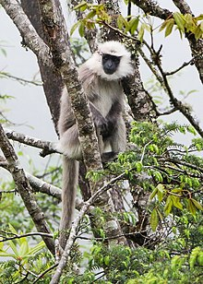
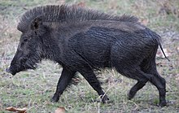
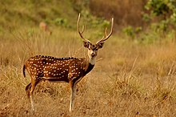
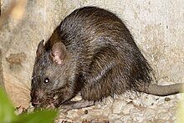
The question
How much do species impact crop yields?
Important to understand in cases where herbivore abundance is increasing dramatically
Different species damage plants in different ways
Different species can east more or less crops

Slide 3
The question
Experimental approach
Four Indian herbivores
Measure damage caused by each to same plant
Controlled density of each species
We want to understand how each species influences crop yield
So, crop ~ species + density?
Species
Crop Yield
Density

Slide 4
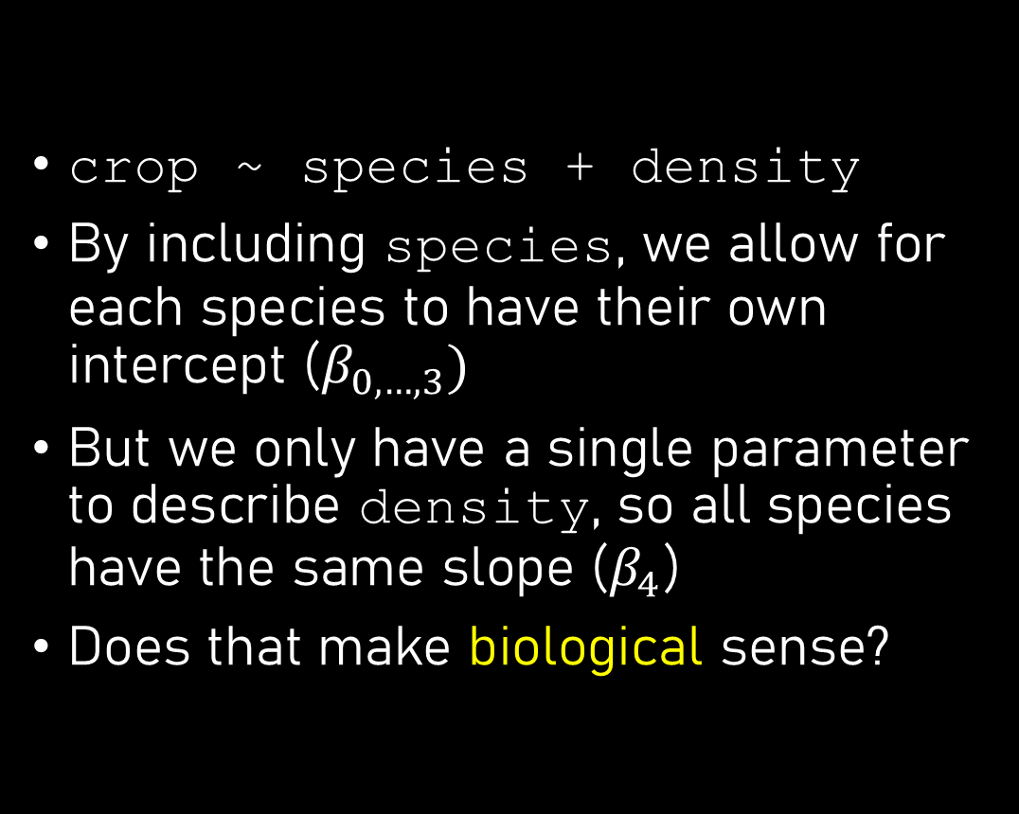
What might the results look like?
crop ~ species + density
By including species, we allow for each species to have their own intercept ($β_{0,…,3})$
But we only have a single parameter to describe density, so all species have the same slope ($β_{4}$)
Does that make biological sense?

Slide 5
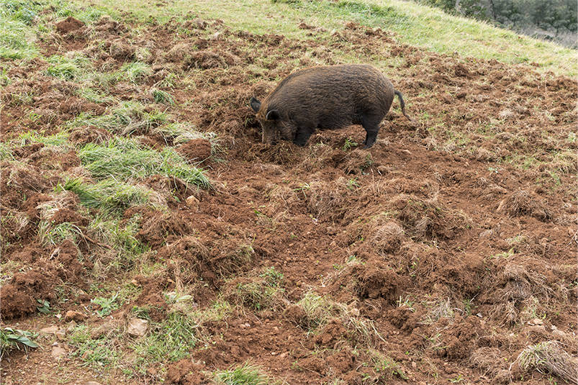
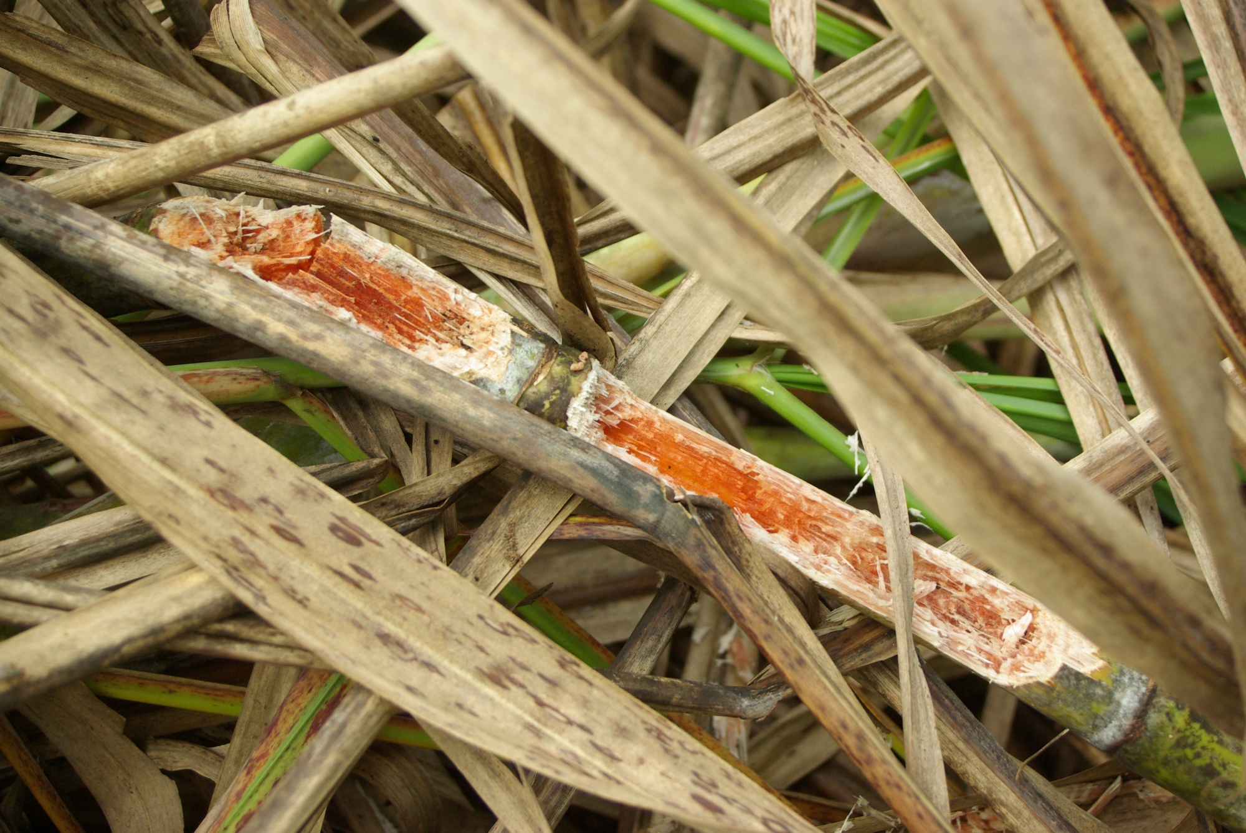
Biological sense?
Species clearly differ
The damage done by each species clearly differ
One boar eats a lot more than one rat
Having 1,000 boar in your field is not the same as 1,000 rats

Slide 6

How do we say 1 rat $≠$ 1 boar?

Slide 7
Is my coffee sweet?
Using only the following information, tell me if my cup of coffee is sweet or not

Slide 8
Is my coffee sweet?
I stir my coffee with a spoon

Slide 9
Is my coffee sweet?
I add sugar to my coffee

Slide 10
Is my coffee sweet?
Sometimes I add sugar to my coffee
Sometimes I stir my coffee

Slide 11
Is my coffee sweet?
I have added sugar to my coffee
And at the same time
I have stirred the coffee

Slide 12
Is my coffee sweet?
To answer question you need to know both pieces of information
But just knowing that sometimes I stir and sometimes I add sugar doesn’t actually help very much
We need to know if both adding sugar and stirring occurred at the same time
How do we tell the model this?

Slide 13
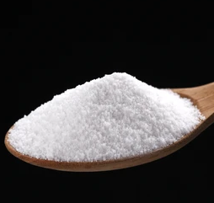

What is an interaction?
Will my tea be sweet?
Sweet ~ sugar + stir
From this, the model doesn’t know that both need to occur at the same time
What if I stirred, but didn’t add sugar?
Treats both variables as being independent of each other
Maybe sweet?
Maybe sweet?
Not Sweet
Not Sweet

Slide 14
What is an interaction?
Interactions specify that an outcome is a result of specific combinations of more than one variable
The effectiveness of a covariate, depends on the other covariate
Sweet ~ sugar * stir
Sweet
Not Sweet
Not Sweet
Not Sweet

Slide 15
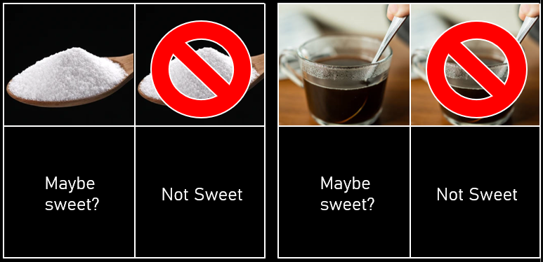
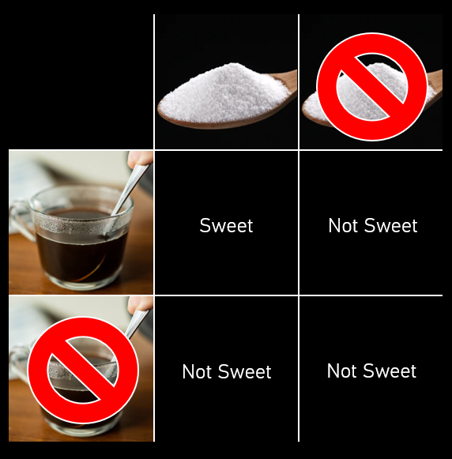

Two ways to specify interactions
The “formal” option
Sweet ~ sugar + stir
+ sugar : stir
$μ_{i}=β_{0}+β_{1}×S_{i}+β_{2}×T_{i}$
$+ β_{3}×S_{i}×T_{i}$
The “shortcut” option
Sweet ~ sugar * stir
$μ_{i}=β_{0}+β_{1}×S_{i}+β_{2}×T_{i}$
$+ β_{3}×S_{i}×T_{i}$

Slide 16
How do we say 1 rat $≠$ 1 boar?

Slide 17
Species
Crop Yield
Density

Slide 18
The question
crop ~ species * density
Species
Crop Yield
Density

Slide 19
What is an interaction?
Sweet
Not Sweet
Not Sweet
Not Sweet

Slide 20
What is our interaction?
 | Spectrum of density (continuous)
 | 0 | 1 | … | 10 | … | 100
Boar | None | Lots | … | Huge |  | Disaster
Deer | None | Medium | … | Lots |  | Lots
Monkey | None | Little | … | Little |  | Medium
Rat | None | None | … | Medium |  | Disaster
 | Spectrum of density (continuous)
 | 0 | 1 | … | 10 | … | 100
Boar | 0 | 2.5 | … | 6.8 | … | 10.6
Deer | 0 | 1.2 | … | 2.3 | … | 3.3
Monkey | 0 | 0.3 | … | 0.4 | … | 0.9
Rat | 0 | 0 | … | 8.5 | … | 15.3

